Slide 1

Data Analysis
Thierry Pécot
Research Associate
Translational Science Lab
Chan Zuckerberg Initiative Imaging Scientist

Slide 2
Software Installation
Windows
  Install R
  Install Rtools
  Open prompt as administrator, activate virtual environement and open R in prompt:
    install.packages('IRkernel')
    IRkernel::installspec(user = FALSE)
    install.packages('devtools')
    devtools::install_github('akoyabio/phenoptr')
    install.packages('ggpubr')
macOS
  Install R
  Open a terminal and type:
    xcode-select –install
    /bin/bash -c "$(curl -fsSL https://raw.githubusercontent.com/Homebrew/install/HEAD/install.sh)“
    brew install libtiff
  Activate virtual environement and Open R in terminal:
    install.packages('IRkernel')
    IRkernel::installspec(user = FALSE)
    install.packages("devtools")
    devtools::install_github("akoyabio/phenoptr")
    install.packages('ggpubr')

Slide 3
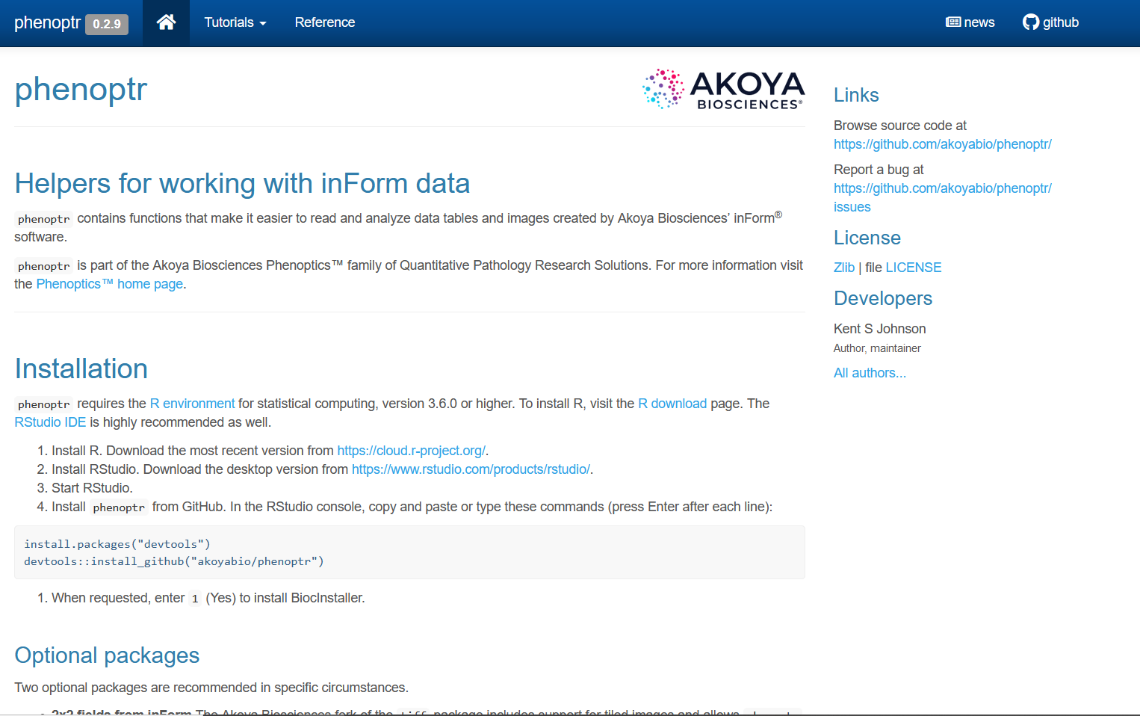

Slide 4
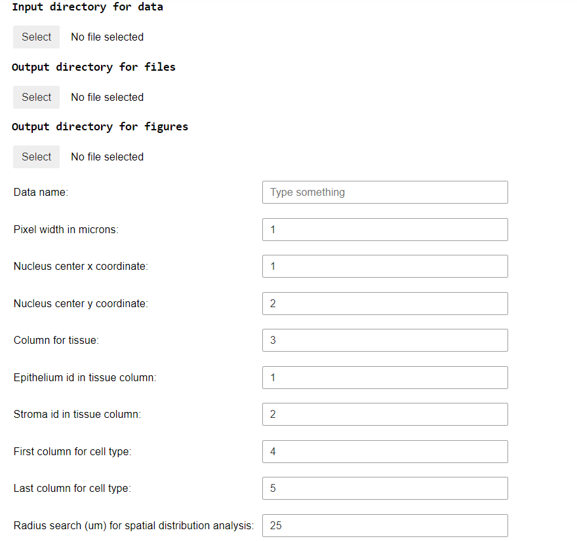
Parameters
Location of files generated with Annotater
Location for output files
Location for output figures
Output name
Pixel size in micrometers
Column for nuclei x coordinate
Column for nuclei y coordinate
Column for epithelium/stroma/background
Id for epithelium
Id for Stroma
1st column for combination of markers
Last column for combination of markers
Radius neighborhood size for spatial distribution analysis

